Slide 1
UNIT – 3 Part I Selection Statements
Programming in C (COM412)
BSc CSIT First Semester
Mid-West University
Birendranagar, Surkhet, Nepal
Prepared by:
Dabbal Singh Mahara
Asst. Prof.
2023

Slide 2
Control Statements
The statements which control or alter the flow of execution of the program are known as control statements.
In the absence of control statements, the instructions or statements are executed in the same order in which they appear in the program (called sequential constructs).
There are two kinds of control statements:
Decision Making Statements (if statement, if…else statement, else if statement, Nested if…else statement, switch statement)
Loop or Repeating Constructs (for loop, while loop, do…while loop)

Slide 3
Selection Statements
Selection statement also known as Decision making and branching” , is one of the most important concepts of computer programming.
Programs should be able to make logical (true/false) decisions based on the condition provided.
Every program has one or few problems to solve. In order to solve those particular problems important decisions have to be made depending on the nature of the problems.
Generally C program execute it’s statements sequentially. But in order to solve problems we may have some situations where we have to change the order of executing the statements based on whether some conditions have met or not. So controlling the execution of statements based on certain condition or decision is called decision making and branching.

Slide 4
START
Read User Input
Making Decision
Condition?
Condition Satisfied
[True]
Condition not Satisfied
[False]
Branching
Perform Some Tasks
Perform Some Other Tasks
Branch 1
Branch 2
Show Result
END

Slide 5
Decision Making & Branching in C
C language possesses decision making and branching capabilities by supporting the following statements:
If statement
Switch statement
Conditional operator statement
goto statement
These statements are knows as decision making statements. They are also called control statements as the control the flow of execution.

Slide 6
IF Statement
It is basically a two-way decision making statement and is used in conjunction with an expression.
It takes the following structure:
if (test-condition)
It allows the computer to evaluate the expression first and then depending on whether the value of the expression or condition is true or false, it transfer the control to a particular statement.
This point of program has two paths to follow, one for the true condition and the other for the false condition.

Slide 7
IF Statement
The if statement can be implemented if four different forms depending on the complexity of the conditions to be tested.
The four forms are:
Simple if statement
If else statement
Nested if else statement
Else if ladder

Slide 8
Simple if Statement- Structure
The general form of a simple if statement is:
if (test_condition)
{
statement-block;
}
statement x;

Slide 9
Simple if Statement
The statement block may consists of a single statement or a group of statements.
If the test_condition is satisfied then the statement block will be executed first then the statement-x will be executed after completing the execution of statement block.
Otherwise if the test_condition doesn’t satisfied then, the statement block will be skipped and the execution will jump to the statement-x.
So in short when the condition is true then both the statement block and the statement-x are executed but in sequence.

Slide 10
Simple if Statement- Flowchart
Entry
test
expression
?
True
statement-block
False
statement - x
Next statement

Slide 11
Simple if Statement-Example
Example with block of statements:
if (marks>=90)
{ marks = marks + bonus_marks;
grade=“A+”;
}
printf(“The mark achieved: %d” , marks);
Condition controlled statement

Slide 12
Simple if Statement
Example of single statement:
if (marks>=90)
marks=marks+ bonus_marks;
printf(“The mark achieved: %d” , marks);
Condition controlled statement

Slide 13
Simple if Statement
What happens if multiple statements follows after the if condition without using the curly brace?
Answer: Then the statement immediately following the if condition is considered as the controlling statement of the if condition. if the condition is true the controlled statement is executed otherwise not. Rest of the statements are executed sequentially.

Slide 14
Simple if Statement
Example:
if (marks>=90) marks=marks+ bonus_marks;
grade=“A+”;
printf(“The mark achieved: %d ” , marks);
Condition controlled statement

Slide 15
#include <stdio.h>
#include <conio.h>
int main()
{
int num;
printf("Enter a number to be tested:");
scanf("%d", &num);
if(num < 0)
{
printf("\nThe number is negative");
}
printf("\nDon't use FACEBOOK while studying.");
getch();
}

Slide 16
if…else Statement
The if…else statement is an extension of the simple if statement.
It is used when there are two possible actions- one when a condition is true, and the other when the condition is false.
The general form is:
if(test expression is True)
{
true-block statement(s);
}
else
{
false-block statement(s);
}
statement-x;

Slide 17
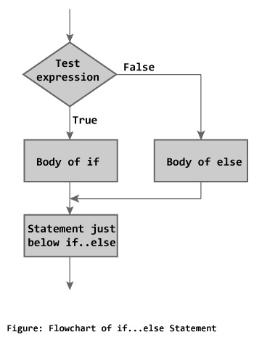

Slide 18
#include <stdio.h>
#include <conio.h>
int main()
{
int num, rem;
printf("Enter a number:");
scanf("%d",&num);
rem = num%2;
if(rem == 0)
{
printf("\nThe number is even.");
}
else
{
printf("\nThe number is odd");
}
printf("\nDon't use MOBILE while studying.");
getch();
}

Slide 19
Example
Write a C program to read the values of coefficients a, b and c of a quadratic equation and find the real roots of the equation. Use if…else statement and If the roots are imaginary, display the message “roots are imaginary”. Calculate imaginary roots too.

Slide 20
#include <stdio.h>
#include <conio.h>
#include <cmath>
int main()
{
float a, b, c, d, root1, root2, real, img;
printf("\nEnter values a, b and c of the quadratic equation:");
scanf("%f %f %f", &a, &b, &c);
d = b*b-4*a*c;
if(d<0)
{
printf("\nImaginary Roots.");
d = sqrt(fabs(d)); //compute absolute value of discriminant
real = -b/(2*a);
img = d/(2*a);
printf("\nRoot1 = %.2f +i %.2f", real, img);
printf("\nRoot2 = %.2f -i %.2f", real, img);
}
else
{
printf("\nRoots are real.");
d = sqrt(d);
root1 = (-b+d)/(2*a);
root2 = (-b-d)/(2*a);
printf("\nRoot1 = %.2f \t Root2 = %.2f", root1, root2);
}
getch();
}

Slide 21
Class Work
Write a program to read two integers from keyboard and check whether the first integer is exactly divisible by the second or not.
Write a program that asks a number from keyboard and tests whether it is a multiple of 7 or not.

Slide 22
If … else if statement
The else if statement is used when there are more than two possible actions depending upon the outcome of test.
When one action is taken, no others can be executed or taken.
In such situation, if…else if…else if…else structure is used.
The general structure is given in coming slide:

Slide 23
Syntax:
if(condition 1)
{
statement-1;
}
else if(condition 2)
{
statement-2;
}
… … … … … … … … …
else if(condition n)
{
statement-n;
}
else
{
default-statement;
}
statement-x;

Slide 24
If …else if statement…
The conditions are evaluated from top to bottom until a true condition is found.
Whenever any One of the conditions becomes True, the statements associated with it are executed and then the control is transferred directly to statement-x; skipping the rest of the structure.
When all the n conditions become false, then the final else containing the default-statement will be executed.

Slide 25
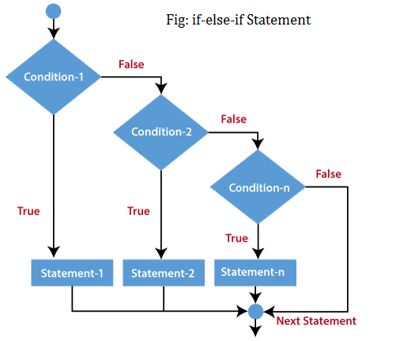

Slide 26
#include <stdio.h>
#include <conio.h>
int main()
{
int n1,n2,n3;
printf("\nEnter 3 numbers:\t");
scanf("%d %d %d",&n1,&n2,&n3);
if(n1>n2 && n1>n3)
{
printf("\n%d is the greatest number.",n1);
}
else if(n2>n1 && n2>n3)
{
printf("\n%d is the greatest number.",n2);
}
else
{
printf("\n%d is the greatest number.",n3);
}
getch();
}

Slide 27
Exercise
Write an algorithm, draw a flowchart and write a C program using else if statement to read the marks of a student in various subjects of First semester, then calculate the percentage obtained by them and output the division. The conditions to be used are:
% greater than or equal to 80 => Distinction
% between 70 and 79 => First Division
% between 60 and 69 => Second Division
% between 50 and 59 => Third Division
% less than 50 => Fail

Slide 28
Nested if…else Statement
If an entire if…else construct is written under either the body of an if statement or the body of an else statement, then such type of construct is called nested if…else statement.
In nested form, the condition for inner if is evaluated only if the condition for outer if is satisfied; otherwise, it is skipped and the else part of the outer if is executed.
The general form is given in coming slide:

Slide 29
if(condition 1)
{
if(condition 2)
{
statement-1;
}
else
{
statement-2;
}
}
else
{
if(condition 3)
{
statement-3;
}
else
{
statement-4;
}
}
statement-x;

Slide 30
If condition 1 is true, then the second test condition 2 is evaluated and statement-1 or statement-2 is executed, depending on the result of condition-2.
If condition 1 is false, then the else portion is evaluated, which contains another test condition 3 => so that either statement-3 or statement-4 is executed depending on the result of condition 3.
Thus, only one of the four statements will be executed will be executed at a time, and after that the control is transferred to the statement-x.
Note: There can be other constructs of nested if…else depending on the presence or absence of if…else inside the outer if…else statements.

Slide 31
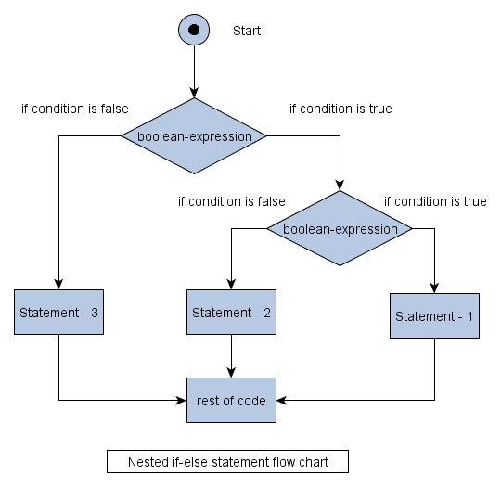

Slide 32
#include <stdio.h>
#include <conio.h>
int main()
{
int n1,n2,n3;
printf("\nEnter 3 numbers:\t");
scanf("%d %d %d",&n1,&n2,&n3);
if(n1>n2)
{
if(n1>n3)
{
printf("\n%d is the greatest number.",n1);
}
else
{
printf("\n%d is the greatest number.",n3);
}
}
else
{
if(n2>n3)
{
printf("\n%d is the greatest number.",n2);
}
else
{
printf("\n%d is the greatest number.",n3);
}
}
getch();
}

Slide 33
switch Statement
When there are a number of else alternatives, switch statement is another way of representing this multi-way selection. (What was one other way???)
The switch statement is useful when a variable is to be compared with different constants, and in case it is equal to a constant, a set of statements are to be executed.
The constants in the case statement may be either char or int type only.
Syntax is provided in coming slide:

Slide 34
switch(variable_name)
{
case caseConstant1:
statements;
break;
case caseConstant2:
statements;
break;
… … … … … … … … …
default:
statements;
}

Slide 35
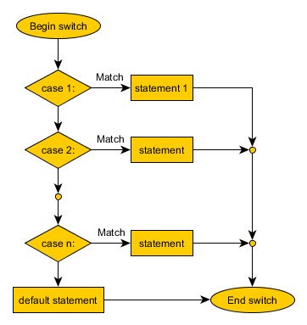
Switch statement

Slide 36
Int main()
{
int choice;
printf("\nWhich of these websites you visit the most?");
printf("\nSelect 1 for FACEBOOK, 2 for YAHOO! and 3 for GOOGLE.");
printf("\n1=>FACEBOOK \n2=>YAHOO! \n3=>GOOGLE\n");
scanf("%d",&choice);
switch(choice)
{
case 1:
printf("\nYou use FACEBOOK.");
break;
case 2:
printf("\nYou use YAHOO!.");
break;
case 3:
printf("\nYou use GOOGLE.");
break;
default:
printf("\nYou have entered an invalid option.");
}
getch();
}

Slide 37
/*Program to add, subtract, multiply and divide two complex numbers using switch statement*/
#include <stdio.h>
#include <conio.h>
Int main()
{
int a,b,x,y,real,img;
char opr;
printf("\nEnter first complex number of the form (a+ib):");
scanf("%d+i%d", &a, &b);
printf("\nEnter second complex number of the form (x+iy):");
scanf("%d+i%d", &x, &y);
printf("\nEnter one of the operators among +, -, *, /:\t");
scanf(" %c",&opr);

Slide 38
switch(opr)
{
case '+':
real = a+x;
img = b+y;
printf("\nThe addition is:%d+i%d.", real, img);
break;
case '-':
real = a-x;
img = b-y;
printf("\nThe subtraction is:%d+i%d.", real, img);
break;
case '*':
real = a*x-b*y;
img = a*y+b*x;
printf("\nThe multiplication is:%d+i%d", real, img);
break;
case '/':
real = (a*x+b*y)/(x*x+y*y);
img = (b*x-a*y)/(x*x+y*y);
printf("\nThe division is:%d+i%d", real, img);
break;
default:
printf("\nInvalid Operator.");
}
getch();
}

Slide 39
goto Statement
The goto statement is used to alter the normal sequence of program execution by unconditionally transferring control to some other part of the program.
The goto statement transfers the control to a labeled statement somewhere in the current function using syntax:
goto label;
Here, label is an identifier used to label the target statement to which the control would be transferred.
The target statement must be labeled using syntax:
label: statements;

Slide 40
/* Program to ask two numbers and display message “Either number is negative”, if one of the numbers is negative; otherwise display message “Both numbers are positive” */
int main()
{
int i, num1, num2;
printf("Enter first no:");
scanf("%d", &num1);
if(num1<0)
{
goto negative;
}
printf("\nEnter second number:");
scanf("%d", &num2);
if(num2<0)
{
goto negative;
}
printf("\nBoth numbers are positive");
getch();
return;
negative: printf("\nEither number is negative");
getch();
}

Slide 41
Homework
What do you mean by control structure?
Discuss different types of decision making statements.
Explain simple if statement with syntax and flowchart.
Explain if else statement with syntax and flowchart.
Demonstrate if else statement with a program.
Illustrate if else if statement with an example.
What is switch statement? Explain with syntax and flowchart.

Slide 42
Thank you !

